Slide 1


Online fruits shop
Name: Meenakshi. K
Destination: Developer
Department: ETPL

Slide 2


AGENDA
01 | Introduction
02 | system software
03 | objective
04 | Flow Diagram
05 | Module

Slide 3
AGENDA
06 | Advantage
07 | Disadvantage
08 | Screenshot
09 | Questions

Slide 4
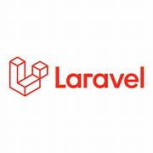
INTRODUCTION
Laravel is an open-source PHP web framework
Designed for building modern web applications.
Developed by Taylor Otwell and released in 2011
Laravel has rapidly gained popularity in the PHP community
Provides with commonly used functions or APIs

Slide 5
INTRODUCTION
Composer Integration: Laravel utilizes Composer, the PHP package manager, to manage its dependencies and make it easy to install and update packages.
Laravel includes an expressive ORM that simplifies database operations.
Routing: making it easy to handle HTTP requests and define custom URL structures.
Blade Templating Engine: This allows developers to write clean and efficient PHP code for their views
Authentication and Authorization: Laravel makes implementing authentication and authorization systems a breeze with its built-in features and easy-to-use APIs.
Artisan Laravel includes a command-line tool called Artisan

Slide 6
Software system

Slide 7
OBJECTIVE
At MM online Fruits shop, we believe in providing our customers with the freshest, juiciest, and most flavorful fruits available.
We source our fruits directly from trusted growers and suppliers, ensuring that each piece meets our stringent standards for freshness and taste.
Just a few clicks, you can browse through our extensive collection, place your order, and have it delivered straight to your home or office.
Whether you're looking for healthy fruits, ingredients for your favorite fruits, or a thoughtful gift for a loved one, MM Fruits Shop has you covered. Experience the ease and pleasure of shopping for fruits online with us today!

Slide 8
Flow diagram

Slide 9
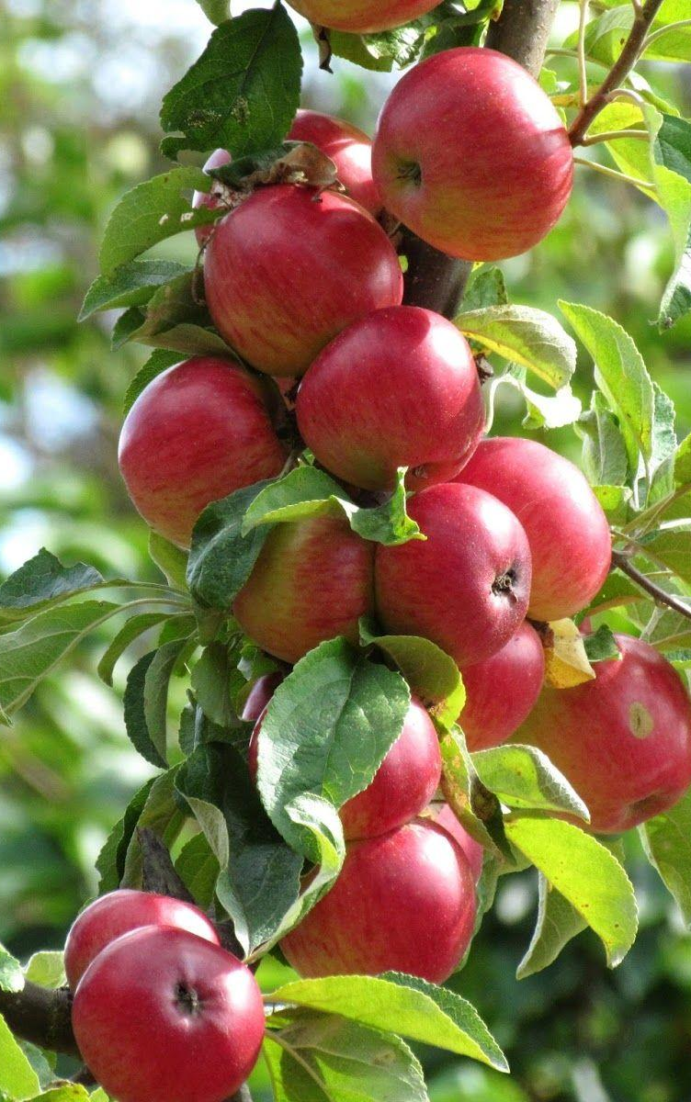
Module
1. User
View Homepage
Add to Cart
Checkout
2. Admin
Create Product
View Product
Update Product
Delete Product

Slide 10


Advantage
making it a popular choice for developers worldwide.
Database Migration System: This makes it easier to manage database changes
Powerful Routing System: To define application routes and handle HTTP requests effectively.
Blade Templating Engine: make it easy to build complex user interfaces

Slide 11

disadvantage
Dependency on Composer Packages
Upgrading Challenges
Security Concerns-CSRF protection
Community Support- like Ruby on Rails or Django

Slide 12
Screen shot

Slide 13
Screen shot

Slide 14
Screen shot

Slide 15
Screen shot

Slide 16
Screen shot

Slide 17

Question?

Slide 18


